Slide 1
GIS and RS for Forest Resource Assessment
Kefyalew Sahle Hawassa University
Wondo Genet College of Forestry and Natural Resources
GIS Department

Slide 3
Unit 4. Forestry cover mapping

Slide 4
Approaches for forest cover mapping
In principle, land cover mapping from satellite data is straightforward and consists of four steps:
data acquisition,
pre-processing,
analysis/classification,
product generation and documentation.

Slide 5
Pre-processing
In principle, image preprocessing entails
geometric and
radiometric corrections.
Remark: For detailed image information on preprocessing, refer to the advance image processing material courses of the department. Contact the department head to access the material

Slide 6
Pre-processing Coarse resolution data
In the past, some classification projects employing coarse resolution data were carried out with single-date, relatively cloud-free images.
However, this approach is fundamentally limited because the probability of cloud-free scenes decreases as the area covered by one scene increases.
It is thus very difficult to obtain useful images for land cover mapping, especially if the eligible time interval is short.
Furthermore, such images contain systematic errors due to atmospheric effects (as a function of the path length) as well as monotonically changing spatial resolution for most coarse resolution sensors.
Their classification is therefore difficult and requires interactive fine tuning for each input scene used, as well as post-classification operations to reconcile differences between adjacent scenes to ensure consistency across the mapped area.
For these reasons, research in recent years has emphasised the use of image composites.

Slide 7
Pre-processing Coarse resolution data - compositing
In a compositing process, the image product is prepared so as to contain, as far as possible, information about the land surface itself.
Since a large fraction of the pixels typically contain clouds, the main objective of the procedure is to select the most cloud-free measurement from those available for a given pixel of the composite image.
The pixel compositing approach yields nominally cloud-free composites every few days, thus providing a potentially large data set for land cover classification.
However, in this form the data are far from adequate for such a purpose.

Slide 8
Pre-processing Coarse resolution data - compositing
This is because the composites have built-in noise from the varying satellite sensing geometry and from residual clouds or variable atmospheric properties (water vapour, aerosols, ozone).
These effects are normally present between adjacent composite pixels and can lead to large radiometric differences for the same land cover type, thus causing classification errors.
They also have a strong impact on the consistency of satellite data, both within and among years.
The degree of corrections following compositing varies among investigations. Atmospheric corrections are frequently carried out, although nominal / climatological values of some critical parameters are typically used or their effect is ignored (e.g., aerosol).

Slide 9
Pre-processing Fine resolution data
In the past, most land cover studies employing high resolution data were carried out with single images (hereafter called ‘scenes’), parts of scenes or an assembly of such scenes from different areas.
In these cases, radiometric consistency was not an issue because the classification could be optimized individually for each scene.
When classifying a scene composite (i.e., a mosaic of scenes), the situation is more complicated.

Slide 10
Pre-processing Fine resolution data
In principle, two options are possible.
First (case I), one can classify each scene separately and subsequently reconcile the classes across the mosaic.
Another approach (case II) is to assemble a mosaic of scenes for the entire area, establish radiometric uniformity across the mosaic, and then classify it as one entity.

Slide 11
Pre-processing Fine resolution data
In case I, each scene is treated as a separate data set to be classified, using ancillary data that are appropriate for the classification procedure employed.
It is thus slow and labour-intensive.
The reconciliation of classification across the boundaries between adjacent scenes can be difficult and may require changes in the classification(s) or labelling to be carried out within individual scenes.
Even with these measures, discontinuities between scenes are not necessarily removed if significant radiometric differences were present at the outset.
Thus, even with much intervention by the analyst, post-classification reconciliation does not guarantee success.
On the other hand, case I is highly flexible and can cope with various limitations of the input data.

Slide 12
Pre-processing Compositing
Because of the infrequent satellite revisits, the compositing of fine resolution data over large areas (case II) employs entire scenes, as opposed to individual pixels in the coarse resolution data.
Thus, although radiometric noise is still present, it takes on different forms.
First, atmospheric contamination is less limiting because only mostly cloud- and haze-free scenes (preferably <10%) are used for this purpose.
Second, bidirectional problems are much less severe, particularly in the case of nadir-looking sensors with a narrow field of view such as the Landsat Thematic Mapper (TM) or Satellite Probatoire d’Observation de la Terre High Resolution Visible Imaging System (SPOT HRV) in nadir mode.

Slide 13
Pre-processing Compositing
A substantial amount of research has been carried out in the area of radiometric equalization across scene composites.
Typically, the algorithms utilize overlaps between adjacent scenes to establish the correction factors.
These corrections have been carried out interactively or they can be automated.
However, reconciling adjacent scenes may not be sufficient in larger scene composites.
An overall adjustment within the scene composite is preferable, in which the inconsistencies and radiometric differences are balanced to an overall optimum.
This is conceptually similar to block adjustment employed in photogrammetry, and can be implemented for scene compositing purposes.

Slide 14
Pre-processing Compositing
With such adjustments, the radiometric errors are minimized across the composite, based on the magnitude of the differences detected in the overlapping areas.
These differences can conveniently be detected using overlaps with adjacent scenes or orbits.
Because of the scale relationships between scene size and the size of atmospheric high-pressure areas, adjacent scenes along the orbit often have similar cloud contamination.
Even in radiometrically corrected scene composites, some noise will remain.
The most important sources are local atmospheric effects such as haze, smoke or cumulus clouds in an otherwise clear-sky scene.
Small but potentially significant bidirectional reflectance effects may also be present, These residual effects must be dealt with in the classification process.

Slide 15
Pre-processing Phonological differences
In addition to purely radiometric noise, the uniformity is also affected by phenological differences among scenes that are more difficult to address.
Potential solutions include enlarging the window during which acceptable data are acquired, usually by adding years from which data may be used; using data from other similar sensors; or attempting a ‘phenological correction’ based on seasonal trajectories established for similar targets.
Such corrections would be required prior to scene compositing.
The use of scenes from various sensors in a composite has not yet been explored.

Slide 16
Pre-processing Phonological differences
In principle, it requires pre-processing the data from the added sensor to resemble the initial one: both spatially and spectrally.
Spatial resolution presumes resampling to the same pixel size – a routine operation.
Spectral adjustment is conceptually more difficult, and its feasibility will depend on the differences between the two sensors and the spectral characteristics of the targets in the imaged scene.
The solution is easiest when the added sensor has more than one spectral band where the initial sensor has only one. The inverse situation has no satisfactory solution and may render the added data set unsuitable.
It should be noted that the last two options (phenological correction and compositing scenes from various sensors) will also add radiometric noise of their own. Some form of between-scene reconciliation is therefore likely to be required in many cases.
This and the inevitable residual noise in the scene composite suggest that while the case II application may be the preferred solution, in practice it may often have to be supplemented by case I to obtain quality land cover maps.

Slide 17
Classification
Land cover information that can be gleaned from satellite images is the spectral and spatial attributes of individual cover types.
There are some differences between coarse and fine resolution data, mainly in the relative importance of these two kinds of attributes.
Because of the reduced resolution, the spectral dimension is the most important source of cover type information in coarse resolution images.
For fine resolution data, the relative importance of the spatial dimension is higher, although the spectral content still dominates in most cases.
In the following discussion, no distinction is therefore made between the two data types.

Slide 18
Methods of classification
Which methods of image classification do you know?
Produce a brief report on the different types of mage classification:
The method name
Principle
The input data
The output of the classification
Advantages and disadvantages

Slide 19
Manual Classification
Manual, or visual, classification of remotely sensed data is an effective method of classifying land cover especially when the analyst is familiar with the area being classified.
This method uses skills that were originally developed for interpreting aerial photographs.
It relies on the interpreter to employ visual cues such as tone, texture, shape, pattern, and relationship to other objects to identify the different land cover classes , The primary advantage of manual interpretation is its utilization of the brain to identify features in the image and relate them to features on the ground. The brain can still beat the computer in accurately identifying image features. Another advantage is that manual classification can be done without a computer, instead using a hardcopy version of a satellite image.
The downside of manual interpretation is that it tends to be tedious and slow when compared with automated classification and because it relies solely on a human interpreter it is more subjective. Another drawback is that it is only able to incorporate three bands of data from a satellite image since the interpretation is usually done using a color image comprised of red, green, and blue primary colours.
The technique used in manual interpretation is fairly simple. The analyst views the image on either a computer screen or a hardcopy printout and then draws a polygon around areas that are identified as a particular land cover type. If the land cover delineations are done on a computer screen the land cover map is created during the delineation process. If the interpretation is done on a hardcopy image the resulting map will have to be digitized to convert it into a machine readable format.

Slide 20
Digital Classification
Numerical techniques for satellite image classification have a long tradition, dating back to at least the early 70s, two types of approaches have evolved and, in spite of recent developments, have remained as the basic options.
They differ in the assumptions made about the knowledge of the scene to be classified.
In supervised classification, a priori knowledge of all cover types to be mapped within the classified scene is assumed.
This knowledge is used to define signatures of the classes of interest, to be applied to the entire scene.

Slide 21
Digital Classification
In unsupervised classification, no prior information about the land cover types or their distribution is required.
Unsupervised classification methods divide the scene into more or less pure spectral clusters, typically constrained by pre-defined parameters characterizing the statistical properties of these clusters and the relationships among adjacent clusters. The assignment of land cover labels to individual spectral clusters is made subsequently on the basis of ground information, obtained in the locations indicated by the resulting clusters.

Slide 22
Digital Classification
In recent years, numerous variants of these two basic classification methods have been developed.
These include decision trees; neural networks, fuzzy classification and mixture modeling for supervised classification; and classification by progressive generalization, classification through enhancement, and post- processing adjustments for unsupervised techniques.

Slide 23
Digital Classification
It seems evident that when one knows what classes are desired and where they occur (at least as a sample), supervised classification strategies are preferable.
However, over large areas the distribution of classes is not known a priori. This is compounded by the spatial trends in spectral signatures, resulting in the well known signature extension problem.
These complexities render sample selection very difficult and often arbitrary.
Thus, where spatial distribution information is not available, e.g., when mapping a large area previously not well known, unsupervised classification is arguably the better strategy, although a supervised method has also been used in such case.
Unsupervised classification provides more comprehensive information on the spectral characteristics of the area, presents spectrally pure clusters for the labelling step, and gives the opportunity to the analyst to group similar clusters into a smaller number of land cover classes.
Perhaps the major problem with unsupervised classification is the effect of controlled parameters (e.g., number of clusters, allowable dispersion around a cluster mean), for the same data set, changes in these can produce different final clusters.

Slide 24
Consideration in land cover classification
An important consideration in land cover classification is consistency and reproducibility.
That is, the same result should be obtained by various analysts given the same input data or ideally, even different input data over the same area.
In practice, this means that as much as possible of the analysis should be done with objective, analyst- independent procedures.
On the other hand, the analyst cannot be entirely excluded from the process because any classification is a human construct, imposing an artificial scheme on the natural world.

Slide 25
Image segmentation
Segmentation and classification tools provide an approach to extracting features from imagery based on objects.
These objects are created via an image segmentation process where pixels in close proximity and having similar spectral characteristics are grouped together into a segment.
Segments exhibiting certain shapes, spectral, and spatial characteristics can be further grouped into objects.
The objects can then be grouped into classes that represent real-world features on the ground. Image classification can also be performed on pixel imagery, for example, traditional unsegmented imagery.

Slide 26
Image segmentation
The object-oriented feature extraction process is a workflow supported by tools covering three main functional areas: image segmentation, deriving analytical information about the segments, and classification.
Data output from one tool is the input to subsequent tools, where the goal is to produce a meaningful object-oriented feature class map.
The object-oriented process is similar to a traditional image, pixel-based classification process, utilizing supervised and unsupervised classification techniques.
Instead of classifying pixels, the process classifies segments, which can be thought of as super pixels.
Each segment, or super pixel, is represented by a set of attributes that are used by the classifier tools to produce the classified image.

Slide 27
Hybrid Approach
A hybrid approach combines the advantages of the automated and manual methods to produce a land cover map that is better than if just a single method was used. One hybrid approach is to use one of the automated classification methods to do an initial classification and then use manual methods to refine the classification and correct obvious errors. With this approach a reasonably good classification can be obtained quickly with the automated approach and then manual methods can be used to refine the classes that did not get labeled correctly.

Slide 28
Land use /Land Cover map generated using manual classification Heads-Up digitisation approach.
The editing process requires that the analyst be able to compare the classified map with either the original satellite image or some other imagery that can be used to identify land cover features. To compare a classified map with imagery it is helpful to have access to software that allows the analyst to flicker between two images (the land cover image and the original satellite image) or slide one image over the other on the computer display using a technique often called “swiping”. By doing these comparisons the analyst gets a sense of the quality of the classification. When errors are spotted they can be edited using tools common in many image processing software packages. In most cases, visually editing a classified map will improve the accuracy of the final product.

Slide 29
Manual digitizing of forest cover
Other methods of classification in vogue

Slide 30
Manual digitizing of forest cover
Method
Manual Digitizing is often tedious and tiring to the operators. In the old method, the operator traced map features on a transparency and attached this map to the computer screen. In the new method of heads-up digitizing, a scanned map image (aerial photograph and/or satellite image) is used digitally to trace the outlines into a GIS layer
The old method
Manual digitizing requires a digitizing board which may range in size from small tablets of 30x30 cm to large digitizing tables of 120x180 cm.
In the process of digitizing, the map is fixed to the digitizing board using masking tape.
Digitizing is often tedious and tiring to the operators. Apart from ensuring that operators are well trained, it is therefore important to provide a good operating environment including an ergonomically appropriate digitizer setup. Consistent GIS software macros that guide the operator and quality control procedures will minimize errors during digitizing and reduce the time required for later editing.

Slide 31
New method
A form of data input that does not use a digitizing tablet is sometimes called heads-up digitizing.
In the new method of heads-up digitizing, a scanned map image is used digitally to trace the outlines into a GIS layer. The operator uses a scanned map, air photo or satellite image as a backdrop. The image has been georeferenced, in that the image has been converted to a format with the same projection and real-world coordinate system as the other layers in the GIS project. The analyst converts the image by using control points and “tethering” the image to known locations both in the rest of the layers and in the real world. Good control points include street intersections and landmarks. The analyst then traces features with a mouse off the scanned image, creating a new layer in the process.
Head-up digitizing is similar to manual digitizing in the way the lines have to be traced by hands, but it works directly on the computer screen using the scanned raster image as a backdrop.

Slide 32
Manual digitizing procedure Disadvantages
Digitizing is tedious possibly leading to operator fatigue and resulting quality problems which may require considerable post-processing;
Manual digitizing is quite slow;
In contrast to primary data collection using GPS or aerial photography, the accuracy of digitized maps is limited by the quality of the source material.

Slide 33
Errors related with digitizing
Manual digitizing is error prone. After selected point and line features on the map have been converted into digital coordinates in the computer, there is often an additional amount of editing required to deal with any remaining errors or omissions.
Objective is to produce an accurate representation of the original map data. This means that all lines that connect on the map must also connect in the digital database. There should be no missing features and no duplicate lines. Some of the common digitizing errors shown in Figure can be avoided by using the digitizing software’s snap tolerances that are defined by the user. For example, the user might specify that all endpoints of a line that are closer than 1 mm from another line will automatically be connected (snapped) to that line. Small sliver polygons that are created when a line is digitized twice can also be automatically removed. However, only some of the problems can be resolved in this way. Manual correction of digitizing errors after careful comparison of the original and the digitized map remains a necessary component of the data conversion process.

Slide 34
Integrating the attribute data with the spatial data
After the completed digital database has been verified to be error-free, the final step is to add additional attributes. These can be linked to the database permanently, or the additional information about each database feature can be stored in separate files which are linked to the geographic database as needed. The figure below shows the compartments digitized and the attribute tables including compid, area in ha, species, dbh, height, volume per ha, number per ha. These data are from inventory summary.

Slide 35
Digital image classification

Slide 36
Input for image classification
Single date or multi-date images
Single and multi-date image classification refer to the two different methods used to analyze satellite or aerial images. In single-date classification, an image is analyzed and classified in isolation, meaning that only the data from that specific image is used for analysis. On the other hand, multi-date classification takes into account multiple images taken over a period of time. This method uses the information obtained from each image and combines it to create a more comprehensive and accurate classification of the area in question.
Single-date classification is a commonly used method for analyzing satellite and aerial images. This method is relatively simpler to implement and requires less data compared to multi-date classification. Single-date classification is suitable for mapping static features such as land use, vegetation, and water bodies, as well as for detecting changes in an area over time. However, the results obtained through single-date classification may not be as accurate as those obtained through multi-date classification since they do not take into account the changes in the area that may have occurred between the time when the image was taken and when the analysis is carried out.
Multi-date classification, while more complex and data-intensive than single-date classification, offers more accurate results. This method takes into account the changes that may have occurred in an area over time and uses this information to create a more comprehensive classification map. Multi-date classification is also useful in monitoring land use changes, vegetation cover changes, and urban growth. However, multi-date classification requires a significant amount of data and can be time-consuming, making it less practical for some applications.

Slide 37
Procedure for digital image classification
Remark: For detailed procedure of the image classification, refer to advanced GIS and Remote sensing course materials.
The three basic steps for supervised classification are :
Select training areas
Generate signature file
Classify

Slide 38
Algorithm examples
Finally, the last step would be to use the signature file to run a classification. From here, you would have to pick a classification algorithms such as:
Random Forest
Maximum likelihood
Minimum-distance
Principal components
Support vector machine (SVM)
Iso cluster

Slide 39
Explain the major post-classification tasks
Post processing is required in two cases:
The minimum mapping unit of the very final map is larger than the spatial unit used in the classification. Map generalization.
The final map has a vector format and the spatial unit of analysis was the pixel.

Slide 40
The steps required to information extraction depend on the defined mapping approach:
Case 1 A: If the map format is raster and the minimum mapping unit is equal to the pixel size of the input satellite image, the classified image (classification map) is used as it is (i.e., no post processing is required.)
Case 1 B: If the map format is raster and the minimum mapping unit greater than the pixel size of the input satellite image, the classified image (classification map) should be prost-processed (i.e., post processing is required to use the classification map.)

Slide 41
What is the output of the filtering process?
This filtering process removes isolated pixels, or noise, from the classification output. The Majority Filter tool is used to accomplish this task.
The following shows an example of filtering. The first graphic is a raw image from a classification analysis. The second is the same image after filtering has been applied. As you can see, much of the noise is removed as a result.

Slide 42
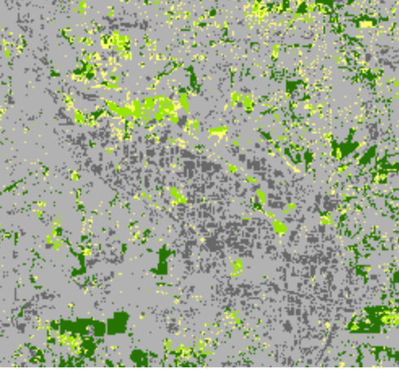
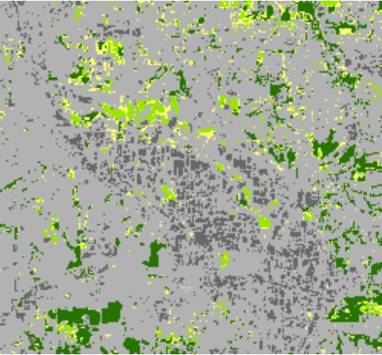
Classified image before filtering: | Image after filtering

Slide 43
Classified image before filtering: | Image after filtering

Slide 44
Un-filtered and filtered image classification maps
What is the difference between the two maps?

Slide 45
Sampling approaches for forest area estimation

Slide 46
Sampling approaches for forest area estimation
Data on land use are often obtained from sample surveys and typically are used for estimating changes in land use or in carbon stocks.
National forest inventories are important examples of the type of surveys used.
This section provides guidance for the use of data from sample surveys for the reporting of emissions and removals of greenhouse gases, and for the planning of sample surveys in order to acquire data for this purpose.

Slide 47
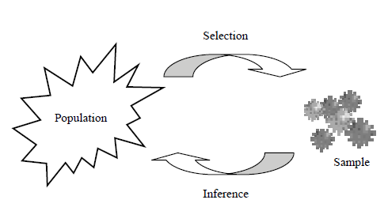
OVERVIEW ON SAMPLING PRINCIPLES
Sampling infers information about an entire population by observing a fraction of it: the sample
Principle of sampling

Slide 48
SAMPLING DESIGN
Sampling design determines how the sampling units (the sites or plots) are selected from the population and thus what statistical estimation procedures should be applied to make inferences from the sample.
Sampling designs should aim for a good compromise between simplicity and efficiency, and this can be promoted by following three aspects as set out below:
Use of auxiliary data and stratification;
Systematic sampling;
Permanent sample plots and time-series data.

Slide 49
Use of auxiliary data and stratification
One of the most important sampling designs which incorporate auxiliary information is stratification, whereby the population is divided into subpopulations on the basis of auxiliary data.
These data may consist of knowledge of legal, administrative boundaries or boundaries of forest administrations which will be efficient to sample separately, or maps or remote sensing data distinguishing between upland and lowland areas or between different ecosystem types.
Since stratification is intended to increase efficiency, it is good practice to use auxiliary data when such data are available or can be made available at low additional cost.

Slide 50
Use of auxiliary data and stratification
Stratification increases efficiency in two main ways:
(i) by improving the accuracy of the estimate for the entire population; and
(ii) by ensuring that adequate results are obtained for certain subpopulations, e.g., for certain administrative regions.

Slide 51
Use of auxiliary data and stratification
Use of remote sensing or map data for identifying the boundaries of the strata (the land-use class sub-divisions to be included in a sample survey) can introduce errors where some areas may be incorrectly classified as belonging to the stratum whilst other areas that do belong to the specific class are missed.
Errors of this kind can lead to substantial bias in the final estimates, since the area identified for sampling will then not correspond to the target population.
Whenever there is an obvious risk that errors of this kind may occur, it is good practice to make an assessment of the potential impact of such errors using ground truth data.

Slide 52
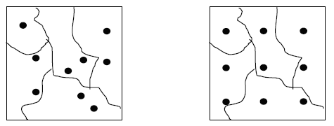
Sampling
Simple random layout of plots (left) and systematic layout (right)

Slide 53
Permanent sample plots and time-series data
Greenhouse gas inventories must assess both current state and changes over time (e.g., in areas of land-use categories and carbon stocks).
Assessment of changes is most important and it involves repeated sampling over time.
The time interval between measurements should be determined based on the frequency of the events that cause changes, and also on the reporting requirements.
Generally, sampling intervals of 5- 10 years are adequate, and in many countries data from well designed surveys are already available for many decades, especially in the forest sector.

Slide 54
Permanent sample plots and time-series data
Nevertheless, since estimates for the reporting are required on an annual basis, interpolation and extrapolation methods will need to be applied.
Where sufficiently long time-series are not available, it may be necessary to extrapolate backwards in time to capture the dynamics of carbon stock changes.
When undertaking repeated sampling, the required data regarding the current state of areas or carbon stocks are assessed on each occasion.
Changes are then estimated by calculating the difference between the state at time t + 1 from the state at time t.

Slide 55
Three common sampling designs can be used for change estimation:
The same sampling units are used on both occasions (permanent sampling units);
Different, independent sets of sampling units are used on both occasions (temporary sampling units);
Some sampling units can be replaced between occasions while others remain the same (sampling with partial replacement).

Slide 56
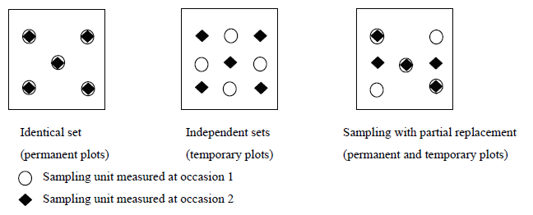
Next figure shows these three Approaches.
Use of different configurations of permanent and temporary sampling units for estimating changes

Slide 57
SAMPLING METHODS FOR AREA ESTIMATION
Many approaches for assessing land-use areas or conversions in areas of land use rely on sampling. Areas and changes in areas can be estimated in two different ways using sampling:
Estimation via proportions;
Direct estimation of area.
Estimation via proportions requires that the total area of the survey region is known, and that the sample survey provides only the proportions of different land-use category.
Direct estimation of area does not require the total area to be known.

Slide 58
SAMPLING METHODS FOR AREA ESTIMATION
Both approaches require assessment of a given number of sampling units located in the inventory area.
Selection of sampling units may be performed using simple random sampling or systematic sampling.
Systematic sampling generally improves the precision of the area estimates, especially when the different land- use classes occur in large patches.
Stratification also may be applied to improve the efficiency of the area estimates; in this case it is good practice to perform the procedures described below independently in each stratum.

Slide 59
ESTIMATION OF AREAS VIA PROPORTIONS
The total area of an inventory region is generally known. In this case the estimation of the areas of different land- use categories can be based on assessments of area proportions.
When applying this approach, the inventory area is covered by a certain number of sample points, and land use is determined for each point.
The proportion of each land-use category then is calculated by dividing the number of points located in the specific category by the total number of points.
Area estimates for each land-use category are obtained by multiplying the proportion of each category by the total area.

Slide 60
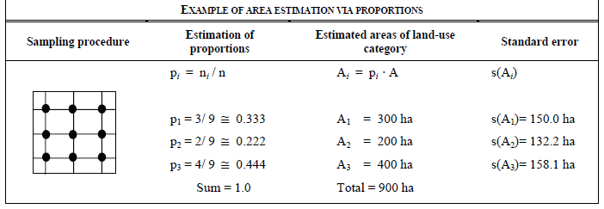
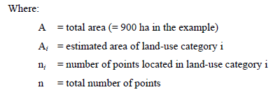

Slide 62

standard error
The table in the previous slide provides an example of this procedure. The standard error of an area estimate is obtained
,where pi is the proportion of points in the particular land-use category i; A the known total area, and n the total number of sample points. The 95% confidence interval for A_{i,} the estimated area of land-use category i, will be given approximately by ±2 times the standard error.
Notes:
The table below provides an example of this procedure. The standard error of an area estimate is obtained , where pi is the proportion of points in the particular land-use category i; A the known total area, and n the total number of sample points. The 95% confidence interval for A_{i,} the estimated area of land-use category i, will be given approximately by ±2 times the standard error.

Slide 63
DIRECT ESTIMATION OF AREA
Whenever the total inventory area is known, it is efficient to estimate areas, and area changes, via assessment of proportions, since that procedure will result in the highest accuracy.
In cases where the total inventory area is not known or is subject to unacceptable uncertainty, an alternative procedure that involves a direct assessment of areas under different land-use classes can be applied.
This approach can only be used when systematic sampling is applied; each sample point will represent an area corresponding to the size of the grid cell of the sample layout.

Slide 64
DIRECT ESTIMATION OF AREA
For example, when sample points are selected from a square systematic grid with 1000 metres distance between the points
If 15 plots fall within a specific land-use class of interest, what will be the area estimate?

Slide 65
DIRECT ESTIMATION OF AREA
For example, when sample points are selected from a square systematic grid with 1000 metres distance between the points, each sample point will represent an area of 1 km ● 1 km = 100 ha.
Thus, if 15 plots fall within a specific land-use class of interest the area estimate will be 15 ● 100 ha = 1500 ha.

Slide 66
Accuracy assessment
Accuracy assessment for manual digitation (see manual digitization part)
Accuracy assessment for digital image classification (see digital classification)
Accuracy assessment for sampling approaches (see sampling approach)

Slide 67
In this section, the accuracy assessment explained in IPCCC will be explained for the
Input for accuracy assessment: Accuracy assessment requires two inputs:
The first is the map to be assessed for accuracy, and
the second is the reference data.

Slide 68
In this section, the accuracy assessment explained in IPCCC will be explained for the
Reference data are assumed true!
Sources of reference data may be:
an existing map
Existing inventory data
Photo-interpreted (high resolution image interpretation)
Collected on the ground (usually preferred although most expensive)
There are two generally accepted approaches to generate reference data / ground truth: use field-collected data of typical classes as samples of ground truth; and another approach relies on image training.

Slide 69
GCP collected from high resolution images:
Generate ground truth based on image training (image interpretation).
This uses typical spectral signatures and limited field experience, where a user can manually specify training areas of various classes using a multispectral image.

Slide 70
The pixels in these training areas are separated into two sets:
one is used to generate class statistics for supervised classification and
the other for subsequent classification accuracy assessment.

Slide 71
To avoid introducing errors because of poor reference data, the reference data must:
Be consistent (use standardized forms)
Use the same classification system as the map
Account for changes over time
Be precisely located
Have quality control

Slide 72
The reference data collection
By far, the most expensive component of an accuracy assessment is the reference data collection.
It is determined by the
Number of sample sites
Type of sites (e.g., field vs photo)
Distribution of sites and ease of access to sites
Amount of data collected at each site
Level of effort required for measurement on the site
Reference data quality control.

Slide 73
What is Error Matrix?
A confusion matrix (or error matrix) is usually used as the quantitative method of characterising image classification accuracy.
It is a table that shows correspondence between the classification result and a reference data.
It is used to estimate the accuracy/error of each class, and over all accuracy.
It uses reference data and the classified image as input to produce the error matrix. The reference data is compared to the land cover map produced through the image classification.

Slide 74
How can there be two values and what do they mean...?
Explain the class accuracy (producer’s and user’s accuracy) and over all accuracy using example (imaginary table)
There are two types of errors: Omission and Commission
Any site that is omitted from the correct class is committed to an incorrect class
These two types of errors correspond to two types of class accuracies: User’s and Producer’s..

Slide 75
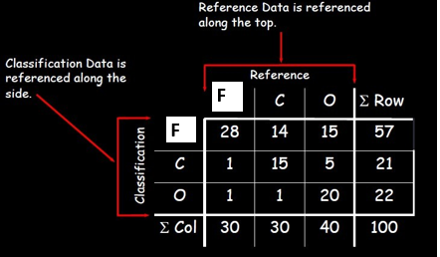
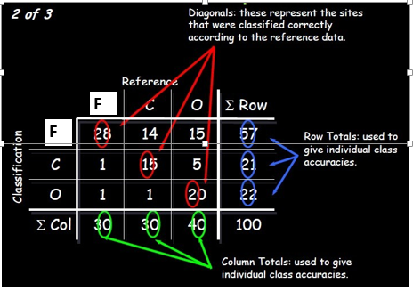

Slide 76
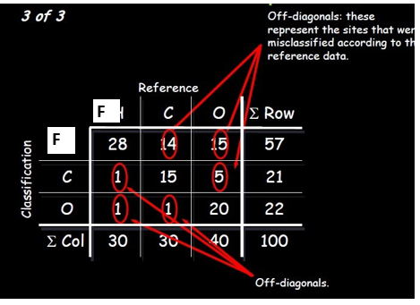
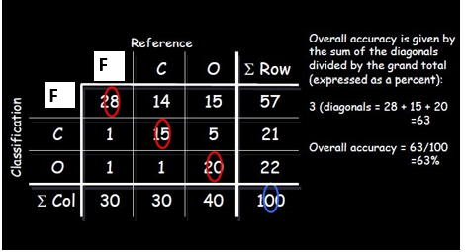

Slide 77
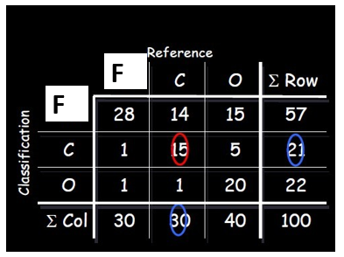
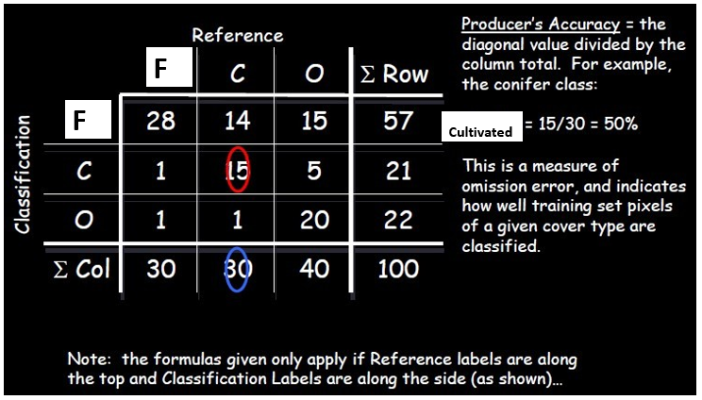

Slide 78
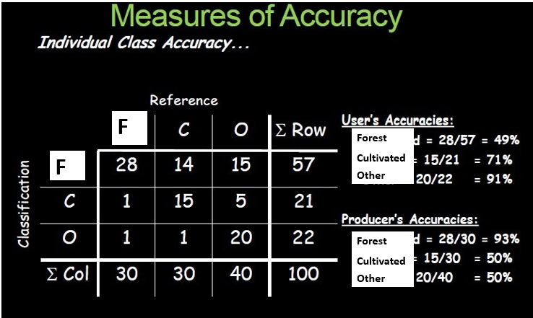

Slide 79
What are the reasons for classification error?
The error matrix really measures differences between reference and classification labels and may not be classification error.
Some reasons for differences:
Classification errors
Registration differences between the reference and map data
Projections, datums, poor quality control

Slide 80
What should be considered when assigning classification errors
The error matrix really measures differences between reference and classification labels and may not be classification error.
When performing accuracy assessment the following points should be considered related to reference data:
Changes in land cover between map and reference data (i.e., time)
Variation in interpretation of reference data
Mistakes in labeling the reference data
Data entry errors
Digitizing errors

Slide 81
Such types of errors related with reference label/data should be minimized
Imposing rigorous quality control
Locating accuracy assessment sites close to polygon centers:
Avoids sampling mixed classes near polygon boundaries and
Reduces errors due to mis-registration
Measure variance within sites

Slide 82
An overview of the accuracy assessment workflow: three geoprocessing tools:
Create Accuracy Assessment Points
Random—Generates random accuracy assessment points across the entire input dataset.
Stratified Random—Generates a set of accuracy assessment points that is proportional in number to the class area for each class.
Equalized Stratified Random—Generates a set of accuracy assessment points where each class has the same number of points.
Update Accuracy Assessment Points, and
Compute Confusion Matrix.
(other options also exist):

Slide 83
An overview of the accuracy assessment workflow (other options also exist): three geoprocessing tools:
After seeing the results of the accuracy assessment, you may need to
adjust training samples or classification parameters, or
choose a different classifier to get a better result.
If this is the case, use
the new classified data as the input to the Update Accuracy Assessment Points and Compute Confusion Matrix using this output.

Slide 84
Computes a confusion matrix
Computes a confusion matrix with errors of omission and commission and derives a kappa index of agreement and an overall accuracy between the classified map and the reference data.

Slide 85
Example of a confusion matrix
 | c_1 | c_2 | c_3 | Total | U_Accuracy | Kappa
c_1 | 49 | 4 | 4 | 57 | 0.8594 | 0
c_2 | 2 | 40 | 2 | 44 | 0.9091 | 0
c_3 | 3 | 3 | 59 | 65 | 0.9077 | 0
Total | 54 | 47 | 65 | 166 | 0 | 0
P_Accuracy | 0.9074 | 0.8511 | 0.9077 | 0 | 0.8916 | 0
Kappa | 0 | 0 | 0 | 0 | 0 | 0.8357

Slide 86
An example of a confusion matrix:
User's accuracy shows false positives, where pixels are incorrectly classified as a known class when they should have been classified as something else. An example would be where the classified image identifies a pixel as impervious, but the reference identifies it as forest. The impervious class has extra pixels that it should not have according to the reference data.
User's accuracy is also referred to as errors of commission, or type 1 error. The data to compute this error rate is read from the rows of the table.
The Total row shows the number of points that should have been identified as a given class, according to the reference data.
Producer's accuracy is a false negative, where pixels of a known class are classified as something other than that class. An example would be where the classified image identifies a pixel as forest, but it should be actually be impervious. In this case, the impervious class is missing pixels according to the reference data.
Producer's accuracy is also referred to as errors of omission, or type 2 error. The data to compute this error rate is read in the columns of the table.
The Total column shows the number of points that were identified as a given class, according to the classified map.
Kappa index of agreement gives an overall assessment of the accuracy of the classification.

Slide 87
Good practices for estimating area and assessing accuracy of land change
The remote sensing science and application communities have developed increasingly reliable, consistent, and robust approaches for capturing land dynamics to meet a range of information needs.
Statistically robust and transparent approaches for assessing accuracy and estimating area of change are critical to ensure the integrity of land change information.
Olofsson et. al (2014) provide practitioners with a set of “good practice” recommendations for designing and implementing an accuracy assessment of a change map and estimating area based on the reference sample data.
The good practice recommendations address the three major components: sampling design, response design and analysis.

Slide 88
Good practices for estimating area and assessing accuracy of land change
Author Olofsson, P., Foody, G.M., Herold, M., Stehman, S.V., Woodcock, C.E. & Wulder, M.E.
Year of publication 2014
http://reddcr.go.cr/sites/default/files/centro-de-documentacion/olofsson_et_al._2014_-_good_practices_for_estimating_area_and_assessing_accuracy_of_land_change.pdf

Slide 89
The primary good practice recommendations for assessing accuracy and estimating area are:
implement a probability sampling design that is chosen to achieve the priority objectives of accuracy and area estimation while also satisfying practical constraints such as cost and available sources of reference data;
implement a response design protocol that is based on reference data sources that provide sufficient spatial and temporal representation to accurately label each unit in the sample (i.e., the “reference classification” will be considerably more accurate than the map classification being evaluated);

Slide 90
The primary good practice recommendations for assessing accuracy and estimating area are:
implement an analysis that is consistent with the sampling design and response design protocols;
summarize the accuracy assessment by reporting the estimated error matrix in terms of proportion of area and estimates of overall accuracy, user's accuracy (or commission error), and producer's accuracy (or omission error);
estimate area of classes (e.g., types of change such as wetland loss or types of persistence such as stable forest) based on the reference classification of the sample units;
quantify uncertainty by reporting confidence intervals for accuracy and area parameters;
evaluate variability and potential error in the reference classification; and
document deviations from good practice that may substantially affect the results.

Slide 91
Activity / discussion
Objective: Separate forest lands into sub-categories of plantation forest (even woodlots) and natural forests.
Problem: Wall to wall mapping using classifier models (e.g., random forest algorithm) and Landsat composite is not accurate, because plantations and (natural) forests have a similar Landsat spectral signature.
Solution:
Automate mapping where we can
Estimate coverage using:
Probability based sample within the mapped Forest areas
High resolution aerial imagery (e.g., Google Earth)
Human brain-eye system
Estimate area using simple statistics

Slide 92
Activity / discussion Workflow:
Define land covers or land uses of interest
Determine which you can map:
Which have distinct spectral signature (candidates for image classification)?
Which are commonly confused?
Select sample design
Photo interpretation of plots
Generate simple statistics

